Slide 1




Slide 1: National Point of Referral – Service Sector and Government Consultations 2023
DRAFT
National Point of Referral – Service Sector
and Government Consultations 2023
A national point of referral to help victims and survivors of child sexual abuse, and others, navigate the service system and access information and resources
In late 2023 to early 2024, the National Office for
Child Safety (National Office), which sits within the
Attorney-General’s Department, undertook a broad
public consultation process to seek feedback from
diverse stakeholders to inform the design and delivery
of a national point of referral. The national point of
referral aims to help victims and survivors of child
sexual abuse, practitioners and the general public to
navigate the service system and access information
and resources. It is anticipated that the referral point
will not directly provide support services, but will be a
central point of access to resources and referrals to
targeted and broad support services. The national point
of referral will address the Royal Commission into Institutional Responses to Child Sexual Abuse recommendation to establish a national website and
helpline to assist victims and survivors of child sexual
abuse to access help and information (Recommendation 9.5). It is Measure 7 under the First National Action Plan
of the National Strategy to Prevent and Respond to Child
Sexual Abuse 2021-2030 (Deliver a website and helpline to assist victims and survivors to access help and information). While the implementation of this measure may include developing a website and helpline, the National Office is considering feedback about other potential features of the referral point and how best to design a service model that offers choice and meets people’s diverse needs. All potential service models for the referral point would be delivered by trained staff who would provide trauma-informed, culturally safe, inclusive and accessible information and support.
Service models
The National Office has undertaken scoping work to explore best practice approaches to support victims and survivors to navigate the service system. During the public consultation process, the National Office asked sector representatives, peak bodies and government agencies about what makes services feel trustworthy, safe and effective, and what features they think the referral point should include. The potential service models are set out below.
A vast majority of participants agreed the national point of referral should reflect a blended approach of online, telephone and face-to-face information and support including a helpline, website and dedicated staff or ‘advocates’/ ’navigators’ who can provide specialist knowledge and assistance to navigate therapeutic, health, social care, justice, legal and other service systems.
Participants spoke about the importance of providing genuine choice of information and engagement options to meet diverse needs and preferences, including options that are anonymous and confidential, and available 24 hours a day, 7 days a week.
Participants highlighted a website should be accessible, clear and easy to navigate and provide information and resources in a variety of formats and languages including fact sheets, infographics, videos, audio and animations.
Participants noted the importance of client-led and flexible telephone support that does not limit call time or place parameters on the help and information provided. This provides the necessary space and time to establish trust.
Participants spoke of the need for professionals who understand the service system and supports available, and who are trained to respond appropriately and adaptively to child sexual abuse in all settings. Participants consistently spoke about the importance of collaborative warm referrals that are informed by local knowledge and local partnerships, as well as the ability to choose who they speak with and to speak with the same professional to avoid ‘retelling’ their story.
National website and helpline
A national helpline and website can enable victims and survivors, practitioners and the general public to access trusted information about appropriate services for children and adults who have experienced child sexual abuse. A helpline can provide people with a central point of contact to speak with staff who know how to work alongside them.
A website could include chat and email
functions and provide information
and resources.
Advocate / navigator
  An advocate or navigator is a trained individual
  who can help people find and access a range of
  supports by identifying and removing barriers,
  facilitating warm referrals to services, and ensuring an individual’s rights and entitlements are achieved. They can also play a role in connecting First Nations people with culturally safe services, helping people with disability to find a disability competent services and linking people from culturally and linguistically diverse communities with culturally appropriate services.
Blended approach
A ‘flexible’ or ‘blended’ approach would involve a combination of service design elements to assist victims and survivors and their supporters, as well as those seeking further information and resources. Such an approach may be necessary to meet the intention of the Royal Commission recommendation
as well as the diverse needs of victims
and survivors, including service
requirements identified during the
consultation process.

Slide 2





Slide 2: National Point of Referral - Service Sector and Government Consultations Summary 2023
DRAFT
National Point of Referral – Service Sector
and Government Consultations 2023
National Action Plan Measure 7 – Consultation approach
Prior to the broad public consultation process in 2023-24, the National Office conducted initial targeted consultations throughout 2022-23 with Commonwealth and state and territory government colleagues, and sector stakeholders to explore best practice approaches to support victims and survivors of child sexual abuse. The National Office heard consistent feedback from stakeholders on the need to avoid duplication of services, engage with people with lived experience and the service sector, and consider a service model that best meets the needs of those seeking help and support.
In August 2023, the National Office engaged First Nations Collective Consulting who partnered with Impact Co., to undertake dedicated
trauma-informed, culturally safe, accessible and inclusive consultations with people with lived experience, First Nations people, people from culturally and linguistically diverse (CALD) backgrounds, and people with disability as part of this broader public consultation process. The National Office also captured feedback through an online survey on the AGD Citizen Space public consultation platform. A summary of this feedback is available in the National Point of Referral - Community Consultations Summary 2023.
Throughout October 2023 – January 2024 the National Office conducted consultation interviews, group discussions and a public submission process with sector representatives, peak bodies and government agencies. The National Office also received feedback from expert advisory groups, including the National Strategy Advisory Group, Child Safe Sectors Leadership Group and National Clinical Reference Group, which include national and jurisdictional service sector representatives, practitioners, National Strategy priority group representatives and peak bodies.
The consultation outcomes will inform the National Office’s approach for finalising, delivering and evaluating the preferred service model for the national point of referral.
How we consulted:
17 interviews
14 written submissions and survey responses
4 group discussions
Who we heard from*:
Health services – 30%
Service providers – 28%
Government agencies – 9%
Advisory groups – 7%
Children’s Commissioners – 7%
Legal services – 7%
Peak bodies – 4%
Advocacy services – 4%
Research organisations – 2%
Religious organisations – 2%
*The primary role of the organisation is included, noting organisations may have multiple functions
Where participants were from:
National – 26%
New South Wales – 21%
Australian Capital Territory – 11%
Victoria – 11%
Western Australia – 9%
Queensland – 6%
South Australia – 6%
Northern Territory – 6%
Tasmania – 4%

Slide 3
Slide 3: National Point of Referral – Service Sector and Government Consultations 2023
DRAFT
National Point of Referral – Service Sector
and Government Consultations 2023
The help seeking journey
What the service sector and government representatives told us about people’s experiences of accessing help and information
Barriers to help seeking
Awareness: Child sexual abuse is a ‘hidden problem that is not well understood.’
Stigma and shame: Disclosing or seeking support for child sexual abuse can feel ‘difficult, sensitive and uncomfortable,’ and may lead to further trauma, reputational damage and social isolation for those impacted.
Service system complexity: The service system is ‘confusing, overwhelming and difficult to navigate’ and there is no ‘simple starting point for information’. There is a lack of national consistency across state and territory legislation, practice and service delivery.
Fear and mistrust: Fear of not being believed, receiving an inadequate response, or being referred to an inappropriate service can inhibit help seeking behaviour and future engagement in the service system. Racism and lack of cultural safety are also additional barriers that First Nations and CALD communities face when seeking help related to child sexual abuse.
Visibility of information and support: It is challenging to find trauma-informed, culturally safe and accessible information and support relating to child sexual abuse. It can be unclear what support and information services provide, and the level of expertise among staff.
Service access: Direct and indirect service costs, lack of access to internet, telephone and personal electronic devices, geographical isolation and living circumstances (e.g. residing in a closed facility) can inhibit access to information and support. Services may also require referrals, applications and the ability to meet eligibility criteria.
Broader social determinants: Individuals operate within diverse and complex social, cultural and family dynamics and may face broader social challenges which impact upon their ability to access help and support. These challenges may include social isolation, housing instability, overcrowding, unemployment, mental illness and substance misuse. First Nations people who experience child sexual abuse can face cultural-tied impacts including disconnection from identity, culture and language; stigma and shame; and intergenerational trauma associated with ongoing institutionalisation.
Service sector challenges
Service availability: Participants described a lack of capacity and resourcing within the service sector to respond to current demand, and to provide follow up information, care and support. Other key issues included slow response times, long waitlists, and a lack of specialist and general support services for priority population groups.
Coordination and collaboration: There can be a lack of awareness across the service sector about the services that exist within state and territory jurisdictions. Collaborative relationships and knowledge sharing are critical to providing ‘joined up and person-centred care’ to victims and survivors with complex needs receiving support across multiple services and/or agencies. The national referral point will need to build strong referral pathways and complement existing services to overcome these challenges.
Maintaining up to date information: Staying up to date with what services are available, where they are located, demand and waitlist information, and contact details is a key service delivery challenge.
Staff recruitment and retention: Key issues include burnout, vicarious trauma, and skill shortages in responding to child sexual abuse and complex trauma. Participants also described the transient nature of the workforce in regional, rural and remote locations.
Pathways to information and support
Pathways vary greatly: Victims and survivors may enter the service system via a referral, or learn about supports online, via word of mouth or through a community group or organisation. Websites, helplines and independent advocacy organisations were considered helpful first points of contact for victims and survivors and their supporters.
Multiple system touchpoints: It is important to leverage all system touch points where resources, information and support can be provided. This includes: community events where families gather, schools, healthcare facilities, family services, mental health services, community centres, websites and social media platforms.
Warm referrals: Staff must be equipped to provide localised information and referrals for the diverse support needs sought by victims and survivors of child sexual abuse including psychological care, health and social care, criminal and civil justice options, redress, child protection, and legal assistance.
Receiving help and information
Face-to-face: The ability to see a person face-to-face can help to build rapport and trust. Face-to-face engagement is particularly important to children and young people, and elderly cohorts.
Helpline: It important to be able to speak to someone 24 hours a day, 7 days a week. A helpline should be able to provide brief and immediate intervention, as well as follow up information and support.
Website: A website should provide high quality, user-friendly and trusted information that is accessible to people in crisis and with varying digital literacy. Websites should also be accessible for people with disability, compatible with mobile phones, and provide information that can be filtered (e.g. by geographical location or priority group).
Other engagement preferences: Web chat and text message are useful methods of providing information, particularly to children and young people. AI can be useful for channelling queries and providing responsive and tailored information but is not a substitute for talking to a person. Online group chats and moderated forums can facilitate opportunities for peer support. Written information, such as fact sheets and handouts are useful for elderly cohorts and CALD communities. Resources, such as videos, animations and audio can provide ‘bite sized’ information that effectively communicates key messages including in a range of languages.

Slide 4
Slide 4: National Point of Referral – Service Sector and Government Consultations 2023
DRAFT
National Point of Referral – Service Sector
and Government Consultations 2023
Trauma-informed, culturally safe and accessible service responses
What the service sector and government representatives told us about service responses that meet people’s diverse needs
Trustworthy and safe services responses
Trauma-informed: Safety, choice, collaboration, trustworthiness, empowerment, and an understanding of complex trauma and how it presents through language and behaviours were described as essential principles of trauma-informed care. Service responses should embed lived experience as well as clinical expertise.
Cultural safety: Cultural safety is more than just the absence of racism or discrimination and more than ‘cultural awareness’ and ‘cultural sensitivity.’ It empowers people and enables them to contribute and feel safe to be themselves. The national point of referral, as well as any service that it provides a referral to, must be committed to creating a culturally safe and trauma-informed environment for staff and service users.
Accessibility: Information and support should be accessible, user friendly, clear and easy to navigate.
Service reputation and credibility: People feel safe when a service or organisation has a trusted reputation, and has demonstrated longevity within the service sector. For some people, government agencies were sources of trustworthy information. Many people considered non-government services to have strong community ties and better placed to provide trauma-informed and culturally safe support.
Highly trained staff: Service reputation is influenced by the quality and training of staff, and their ability to understand and respond sensitively to child sexual abuse in all contexts.
Offering choice and meeting diverse needs
Genuine choice: It is important to provide a range of information and engagement options to meet diverse needs and preferences. One participant explained: ‘Choice is a core way to remove barriers to access to seeking support for
victim-survivors of child sexual abuse.’ Options to speak to speak to someone anonymously and confidentially, and with a support person and/or interpreter contributes to a sense of safety.
‘No wrong door’: People have a right to choose which pathway they want to take. All pathways into, and within, the service system should be trauma-informed, culturally safe, accessible and responsive to victims and survivors of child sexual abuse. People do not want to repeat their story to multiple services.
Support needs vary: Individuals in a state of crisis require immediate support, while others may be gathering information about support options. It is necessary to provide tailored information to victims and survivors of all types of child sexual abuse, as well as parents and family members, children and young people, professionals, people in organisations who have come into contact with victims and survivors of child sexual abuse, and members of the public seeking information or advice. Follow up information and support may also be necessary.
Workforce capability
Specialist child sexual abuse skillset: Responding to child sexual abuse and complex trauma requires specialist skills and knowledge, including the ability to assess risks and ensure safety.
Adaptive response: Staff need to be able to recognise where individuals or families are at a crisis point following disclosure, and be equipped and supported to respond appropriately in accordance with their legal obligations and mandatory reporting requirements. Staff must also have a holistic understanding of the information and supports available.
Diverse workforce: A diverse workforce is necessary to understand and respond to diverse cultural needs and provide culturally safe care to First Nations and CALD communities.
Multidisciplinary teams: Individuals may feel more comfortable seeking support from multidisciplinary teams, which can include counsellors, psychologists, social workers, law enforcement, educators, local service providers, and First Nations health workers.
Workforce wellbeing and support
Task variety: The ability to engage in different streams of work within a role, as well as flexible work arrangements can help prevent burnout and minimise vicarious trauma.
Ongoing workforce development and training: Training should ideally be delivered face-to-face, with options for training to be delivered online to support flexibility, and provided to the whole of practice. This should include ongoing training in vicarious trauma, mental health and first aid.
Clinical and therapeutic supervision: Expert and peer supervision, one-on-one and group debriefing, reflective practice and case reviews provide staff with opportunities for professional development and support.

Slide 5
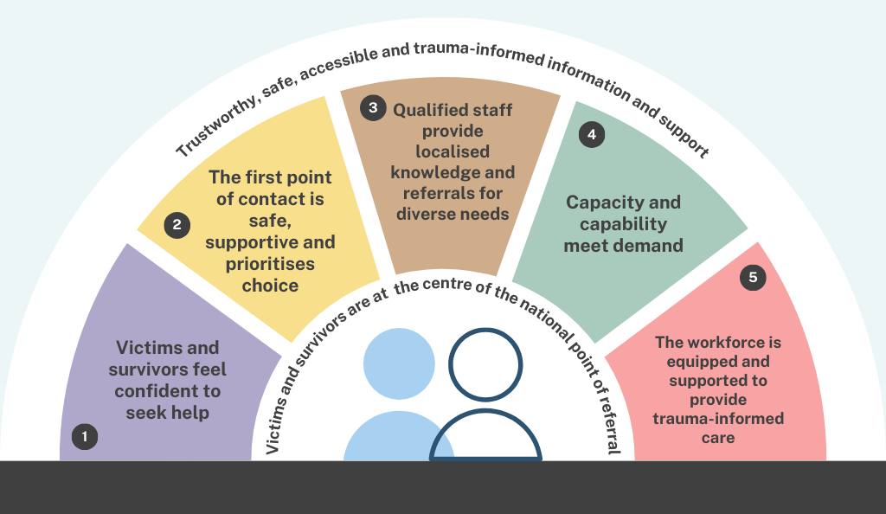

Slide 5: National Point of Referral - Service Sector and Government Consultations Summary 2023
DRAFT
National Point of Referral – Service Sector
and Government Consultations 2023
A national point of referral that offers choice and meets people’s needs
What the service sector and government representatives told us should be the key priorities of the referral point
Qualified staff provide localised knowledge and referrals for diverse needs
Collaborative, warm referrals informed by local knowledge and local partnerships will need to be a key feature of the referral point. Effective warm referrals required localised knowledge and understanding of the service landscape, including knowledge of high-quality and trusted services within a jurisdiction. Tailored information needs to be available and easily accessed.
Capacity and capability meet demand
The referral point needs to be sufficiently resourced to meet demand. It needs longevity and sustainability to establish trust with the community and service sector. Its technical capabilities need to be well-established and reliable to ensure it meets people’s needs. It needs to be integrated with the broader service system, and work to establish the referral point needs to recognise differences across jurisdictions in accessibility and availability of services, their capacity and resourcing.
The workforce is equipped and supported to provide trauma-informed care All staff need to have the capability to be trauma-informed, culturally safe and accessible, and should have a holistic approach to support needs. Responding to complex trauma related to child sexual abuse requires a specialist skillset. Staff need to be trained and supported to understand and respond appropriately and adaptively to child sexual abuse in all contexts, including the ability to assess risks, identify and prioritise needs, and ensure safety. Vicarious trauma and burnout need to be well managed through training, clinical supervision and support, and task variety.
Victims and survivors feel confident to seek help
The national point of referral should be victim and survivor‑centred, meaning it is informed by people with lived experience and works in partnership to value the views and voices of victims and survivors. Staff should adopt a strengths‑based approach that considers people’s intersecting identities and experiences, and work to ensure people are listened to, believed and afforded hope and understanding. The referral point should be client-led and offer choice and flexibility in how help and information are provided. Individuals accessing the service should be involved in decision‑making and have their choices respected.
The first point of contact is safe, supportive and prioritises choice
The referral point needs to be equipped to provide help and information to victims and survivors of all types of child sexual abuse, as well as parents, carers, family members and supporters, professionals and members of the public seeking information or advice. It should respond to diverse needs and ‘meet individuals where they are at.’ The referral point needs to provide tailored approaches to ensure it is culturally safe, accessible, and inclusive for everyone.
Next steps for the national point of referral
Feedback from consultations with sector representatives, peak bodies and government agencies, as well as from individuals and communities (see National Point of Referral - Community Consultations Summary 2023) will inform the design and delivery of the national point of referral. The National Office is working with states and territories to finalise the proposed service model in early-mid 2024.

