Slide 1


Minimum Practice Standards
Specialist and community support services responding to child sexual abuse

Slide 2
Content warning
Child sexual abuse is a challenging issue and listening to this presentation may bring up strong feelings for some people. If this presentation brings up any issues for you, please ask for help if you need it.
In addition to support that may be in place in your service, the National Office for Child Safety Support Services page ChildSafety.gov.au provides a list of dedicated services.
Supports you can reach out to:
Bravehearts on 1800 272 831
Blue Knot Foundation on
1300 657 380
Lifeline on 13 11 14
13YARN on 13 92 76

Slide 3

Acknowledgement of Country

Slide 4


Acknowledgement of victims and survivors

Slide 5
Agenda
What are the Minimum Practice Standards?
Why do the Minimum Practice Standards exist?
Why should service providers adopt and implement the Minimum Practice Standards?
Who do the Minimum Practice Standards apply to?
How can service providers use the Minimum Practice Standards and
Implementation Guide?
How do the Minimum Practice Standards relate to other key guidelines, frameworks and standards?

Slide 6
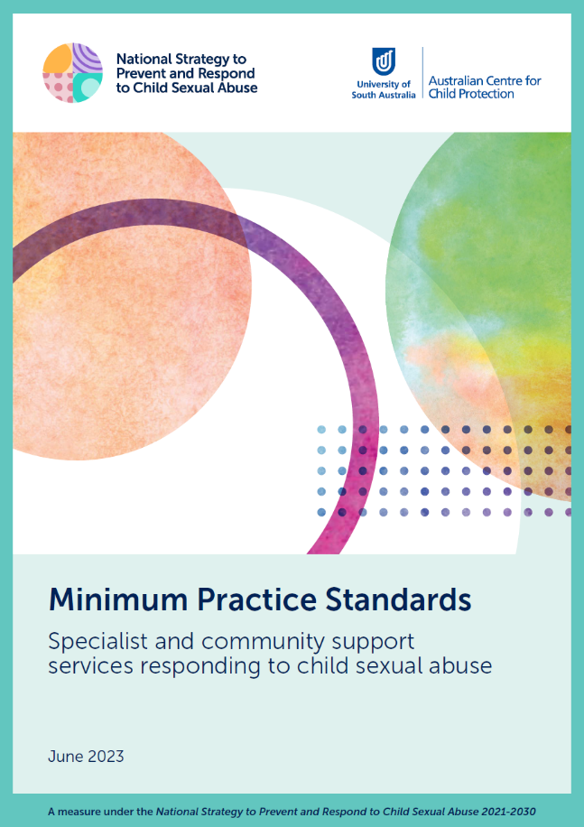


What are the
Minimum Practice
Standards?

Slide 7



Slide 8
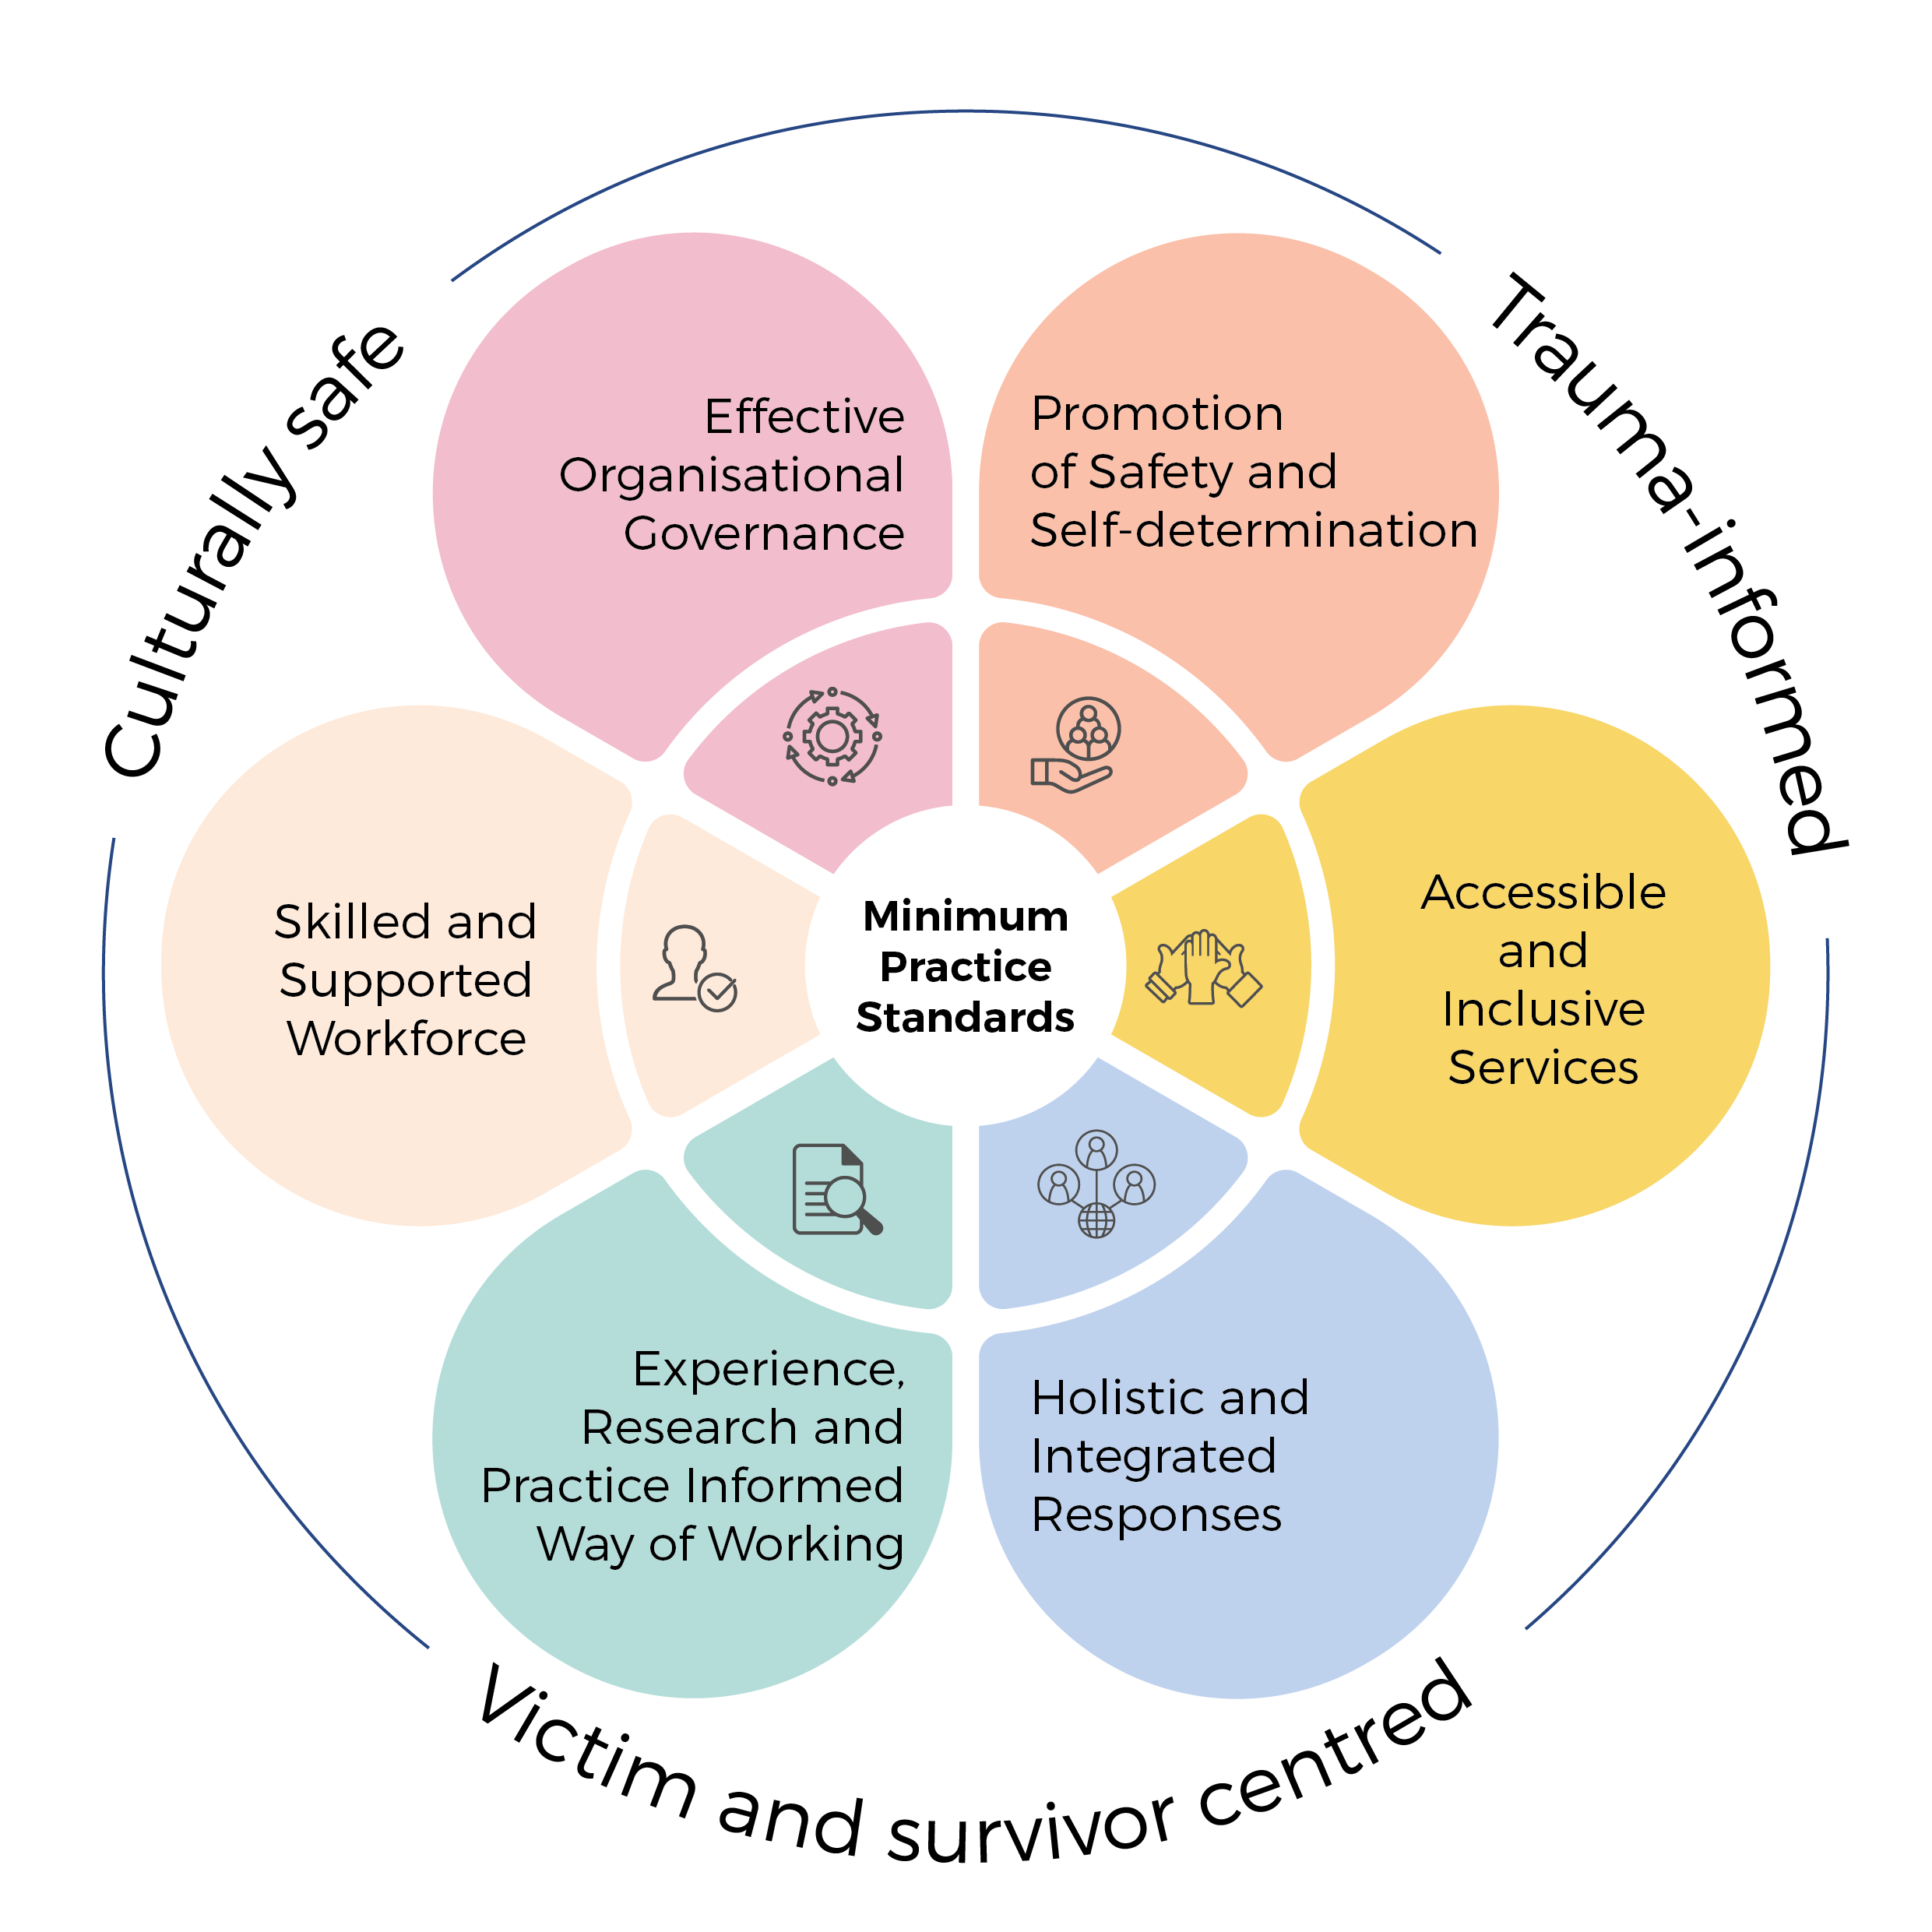
The Minimum Practice Standards
There are 6 standards, underpinned by 3 overarching core values:
Victim and survivor centred
Trauma-informed
Culturally safe

Slide 9

Why do the Minimum Practice
Standards exist?
The National Strategy to prevent and Respond to Child Sexual Abuse 2021-2030 provides a nationally coordinated, strategic framework for preventing and responding to child sexual abuse, including supporting and empowering victims and survivors.
The National Strategy has 62 measures and responds to about 100 Royal Commission recommendations.
The Minimum Practice Standards form a key part of the First National Action Plan Measure 24 under the National Strategy to complete a baseline analysis of specialist and community support services responding to child sexual abuse.

Slide 10

Why should service providers adopt and implement the
Minimum Practice Standards?
Victims and survivors face barriers when seeking help, including gaps in services, inadequate service response, and inconsistent service provision within and across jurisdictions.

Slide 11

Why should service providers adopt and implement the
Minimum Practice Standards?
The Minimum Practice Standards are designed to guide service provision and can support or enhance work that may already be occurring in the sector.
The Minimum Practice Standards provide a set of principles and quality benchmarks to provide safe and effective service provision for victims and survivors to access wherever they
seek help.

Slide 12
Who do the Minimum Practice Standards apply to? (1 of 2)
The Minimum Practice Standards apply to specialist and community support services responding to child sexual abuse across Australia, including:
  survivor and peer-led services
  non-statutory services provided by government and non-government agencies, including Aboriginal Community Controlled Organisations (ACCOs)
  those that offer secondary or tertiary responses
  those providing services to individuals of any age who have experienced or been impacted by child sexual abuse (including parents, partners, siblings, supporters, and advocates)
  those that respond to children and young people who have displayed or who are at risk of displaying harmful sexual behaviours.

Slide 13


Who do the Minimum Practice Standards apply to? (2 of 2)
The Minimum Practice Standards are not designed to apply to:
  general community support services, such as housing support or social wellbeing
  mainstream services, such as police, health, education
  primary intervention services, such as safety or consent education services within schools
  private full fee-based services, such as private psychology clinics
  specific statutory responses such as investigations by police, and wellbeing assessments provided by child protection.

Slide 14
How should the Minimum Practice Standards and implementation guide be utilised?
The implementation guide has been developed to guide implementation across a variety of contexts.
It is intended to help service providers better understand what each standard could look like in practice and how they can demonstrate their implementation.
Implementation of the Minimum Practice Standards will differ across service providers, jurisdictions and service contexts.

Slide 15
STEP 1 | Use the self-assessment tool
1
The implementation guide includes a self-assessment tool to reflect on the organisation’s current practice against the Minimum Practice Standards.
This will highlight areas where they are performing well against the Minimum Practice Standards.
A three-point competency scale designed to assist service providers to consistently assess, self-reflect and evaluate their competency against the Standards.
Working towards
Meeting
Exceeding

Slide 16
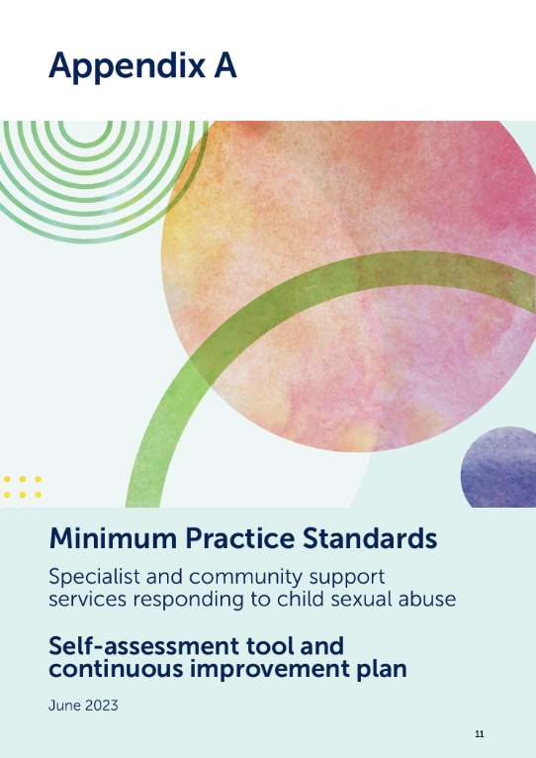
STEP 2 | Make an action plan
2
As part of continuous improvement, organisations should identify areas that they can focus on improving.
For each improvement area, develop an action plan.
The Minimum Practice Standards can be applied flexibly across different organisations and locations.

Slide 17
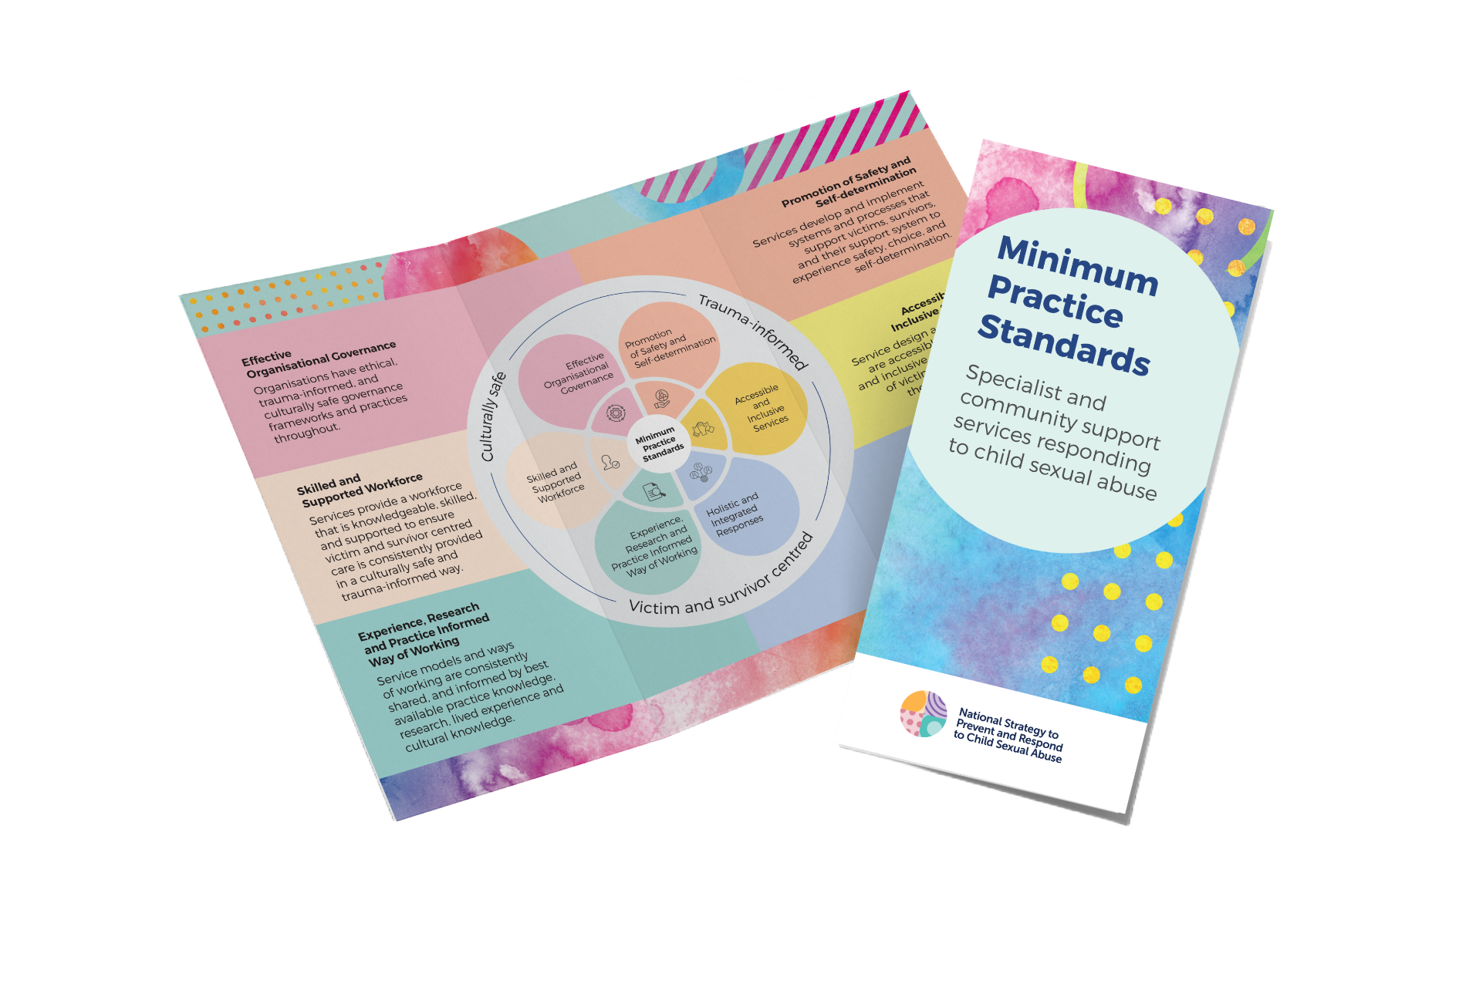



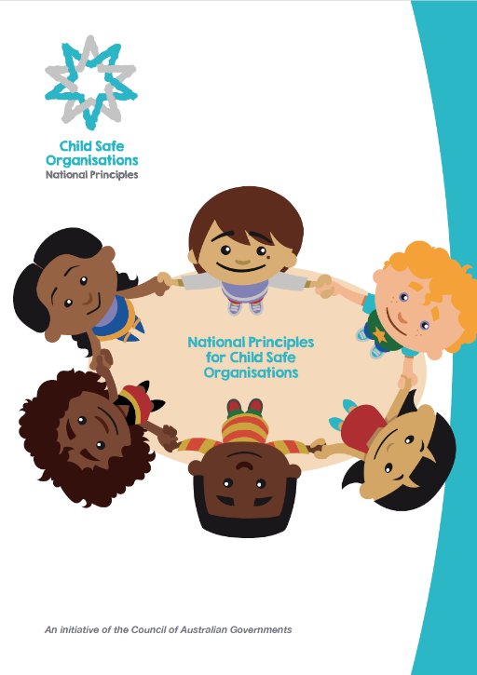



STEP 3 | Identify and use available tools and training
3
Identify and use available tools
and training to help you with
your action plan.

Slide 18
Complementary resources
The Minimum Practice Standards are designed to complement other key guidelines, frameworks, and standards.
The National Centre for Action on Child Sexual Abuse has developed a mapping tool to demonstrate the relationship between the Minimum Practice Standards and other common standards / guidelines.
It is designed for quality assessors, managers, and other staff responsible for ensuring safe and effective services.

Slide 19
Visit ChildSafety.gov.au for more information

Slide 20

Thank you

Slide 21
OPTIONAL
ACTIVITIES

Slide 22
Activity | Conduct a self-assessment
30 min
Open the implementation guide and read through pages 9 and 10
“Assessing implementation of the Standards”.
Choose one of the six Standards and move down to that section of the Implementation Guide.
Go through each indicator under the selected Standard, and:
  Rate your service’s competency against each indicator
  Provide examples of evidence for each competency rating
  Identify whether improvement activities are required
Facilitate a group discussion regarding the perceived strengths and weaknesses of the service each person identified for the selected Standard.

Slide 23
Activity | Make an action plan
30 min
Go to page 35 of the implementation guide, to the “Continuous
improvement plan” template.
Work through populating the blank table for the Standard you have self-assessed against in the self-assessment activity, particularly focusing on indicators that were identified as needing improvement activities.
Write down specific and actionable planned activities that your service can undertake to better demonstrate the indicators and issues identified.
Come back to the group, and each individual will share with the group the action plan they developed for their Standard.

