Slide 1
Parents’ night presentation

Slide 2
Session agenda
Wellbeing and support
About the ‘One Talk at a Time’ campaign
About child sexual abuse
The importance of conversations
Campaign resources
About the National Office’s work
Stay connected

Slide 3
Wellbeing and support
If you need information about reporting child safety concerns, visit: ChildSafety.gov.au/Make-Report
If you need support, you can find a list of dedicated services at: ChildSafety.gov.au/Get-Support
Headspace
Mental health and wellbeing support information
Beyond Blue
Mental Health check-in

Slide 4
About the campaign
The ‘One Talk at a Time’ campaign launched on television, cinema, radio and social media in October 2023.
It aims to protect children and young people by helping adults understand that child sexual abuse is preventable and encouraging them to have ongoing, proactive, preventative conversations with children, young people and other adults.

Slide 5
About the campaign

Slide 6
About child sexual abuse
Understanding what child sexual abuse is, how it occurs, and how to create safe environments for children and young people is an important step in preventing it.
Child sexual abuse can happen anywhere, including by people the child or young person knows or does not know, in families, organisations and online.
No matter what happened or how it happened, child sexual abuse is never a child’s fault.

Slide 7
We all have a responsibility to protect kids

Slide 8
The importance of conversations
You might not be an expert in the topic but no one knows the people in your life better than you do.
You are the right person to have conversations with the children and young people you know about this topic.

Slide 9
Campaign resources
All campaign resources are available on ChildSafety.gov.au

Slide 10
Resources to understand the topic
Get the facts
Grooming factsheet
Informational pages

Slide 11
Resources to guide conversations
The conversation toolkit provides guidance, tips and conversation starters for adults to use with the people in their lives.

Slide 12
Resources to guide conversations
An important way we can ensure that sport environments are safe for children and young people is by making child sexual abuse a key part of conversations when getting kids involved in sport.
The ‘Child Safety in Sport’ webinar focuses on the importance of safety in sport, how sport clubs can champion child safety, and how and when to start conversations about safety in sport.

Slide 13
Resources to use with children and young people
Teeny Tiny Stevies:
One Talk at a Time song
‘My superhero voice’ storybook

Slide 14
Resources to use with children and young people
Series of activities to help children of all ages identify their ‘safety team’ or ‘safety network’, which is a group of adults that they can go to when they feel worried, scared or unsafe.
Also includes resources for adults to build their own support network and understand what it means to be part of a child or young person’s safety team.

Slide 15
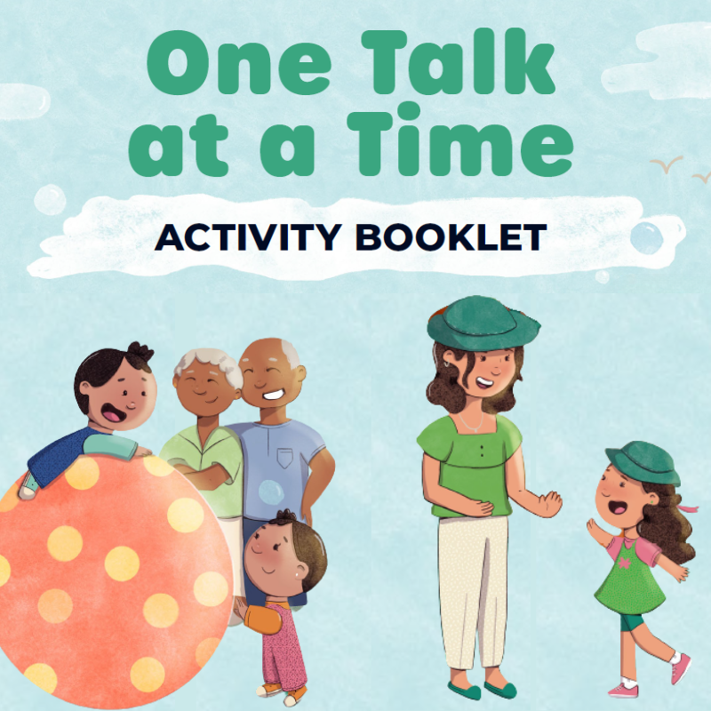
Resources to use with children and young people
Range of resources developed in collaboration with Jayneen Sanders to help teach children and young people about body safety, including video readings of books covering themes of consent, body boundaries and secrets and surprises.
Activity booklet to help adults identify everyday opportunities to start conversations on this topic with children and young people.

Slide 16
Starting conversations about personal safety

Slide 17
About the National Office’s work
The campaign is one initiative under the National Strategy to Prevent and Respond to Child Sexual Abuse 2021-2030, which is led by the National Office.
Find out more about the National Strategy, National Office and all the resources in this presentation at ChildSafety.gov.au

Slide 18
Stay connected
If you’d like receive updates from the National Office, you can subscribe to the mailing list via ChildSafety.gov.au.
You can also follow along on social media for more regular updates: @ChildSafety.gov.au on Facebook, Instagram and LinkedIn.

Slide 19
Protecting children starts with a conversation

