Slide 1
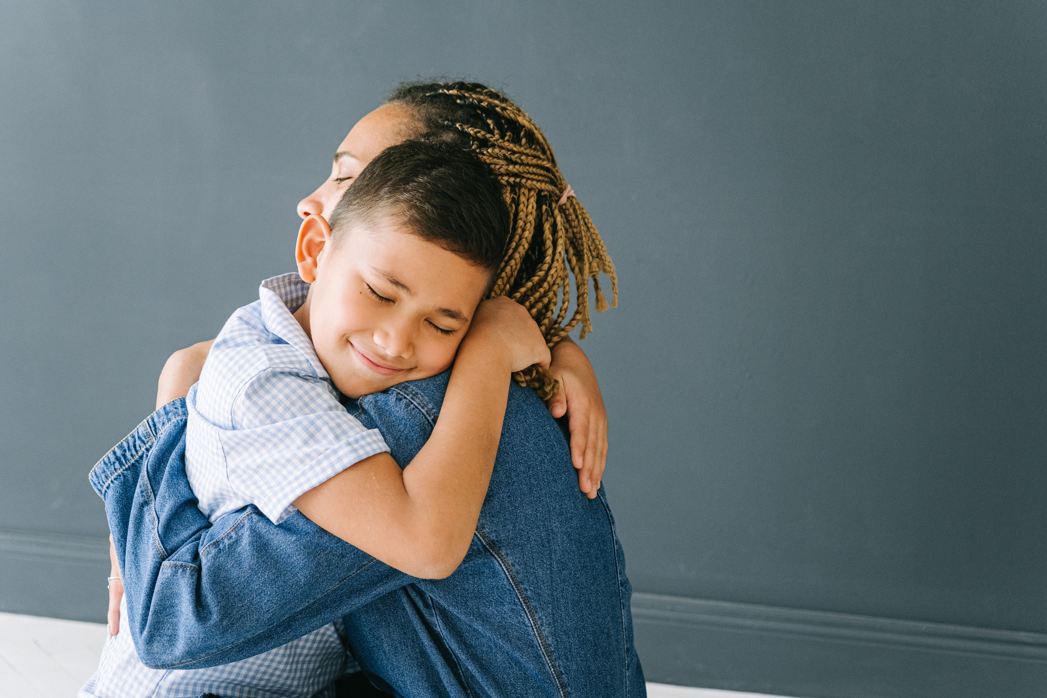
Giving Hugs
This is an example of a social script to teach personal safety concepts for an organisational setting. In this example, their child likes to give and receive hugs as the deep pressure calms them. The goal of this script is to teach the child about consent and trusted people when hugging.

Slide 2
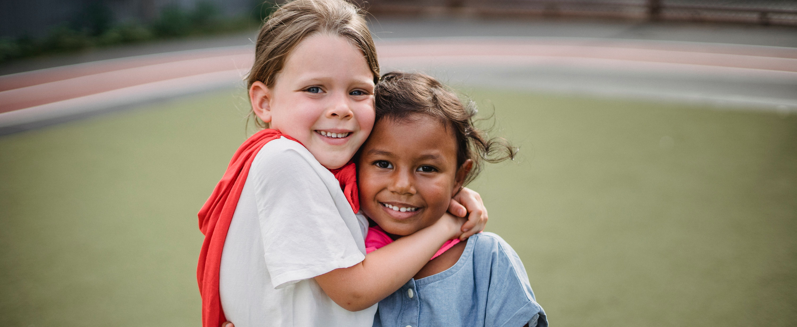
The goal of this resource is not to shame hugging, but to teach when hugs are appropriate and with whom. The emphasis is on safety and consent.
I love to hug people. Hugs feel really good. Hugs show people I care.

Slide 3
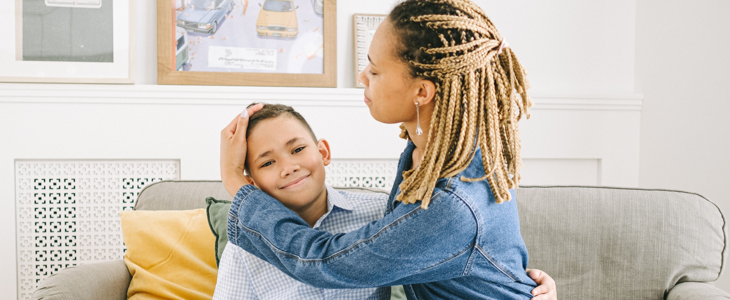
Strong hugs feel the best to me. Other people may like gentle hugs. Gentle hugs are also nice.

Slide 4
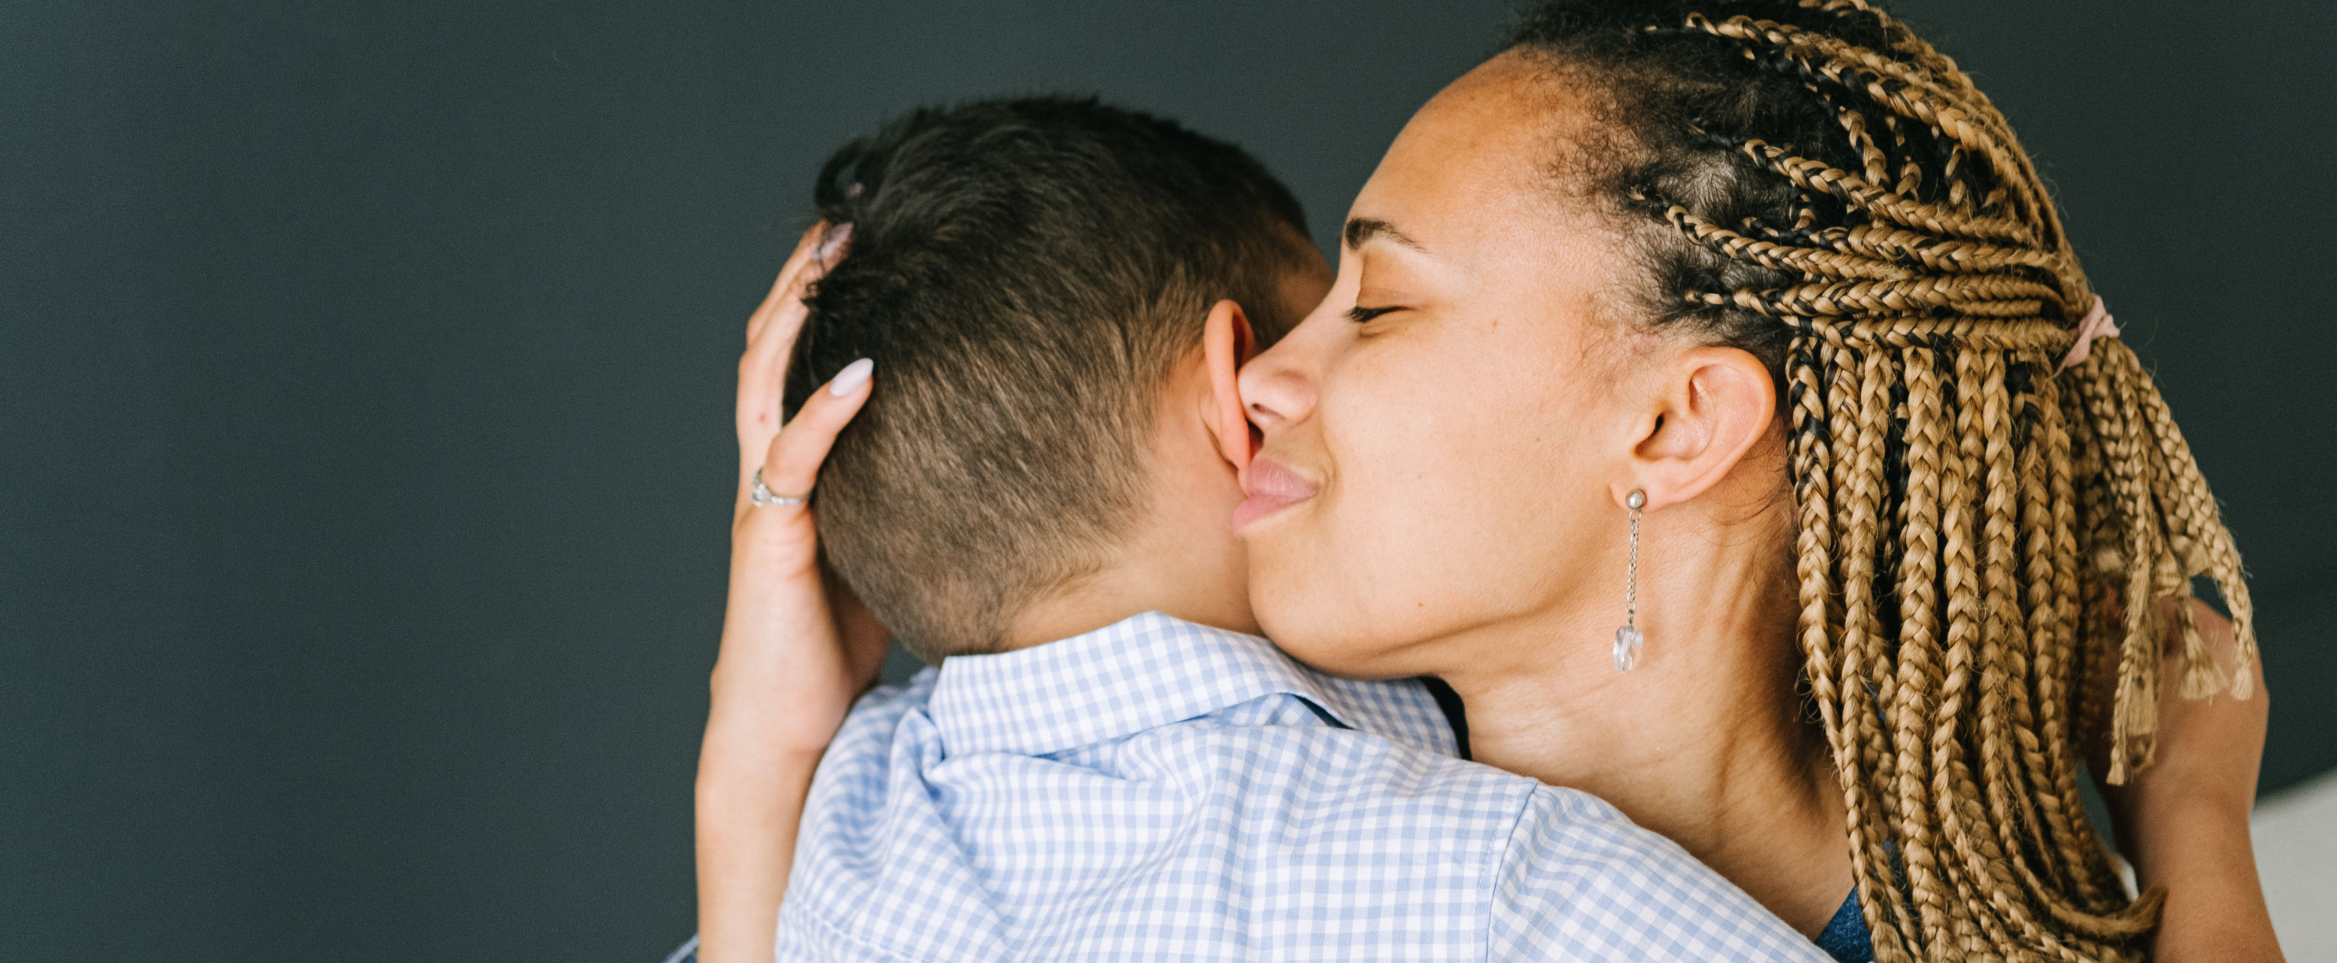
Hugs are for people I know well and trust, like my family and close friends. Hugs can make my friends feel happy.

Slide 5
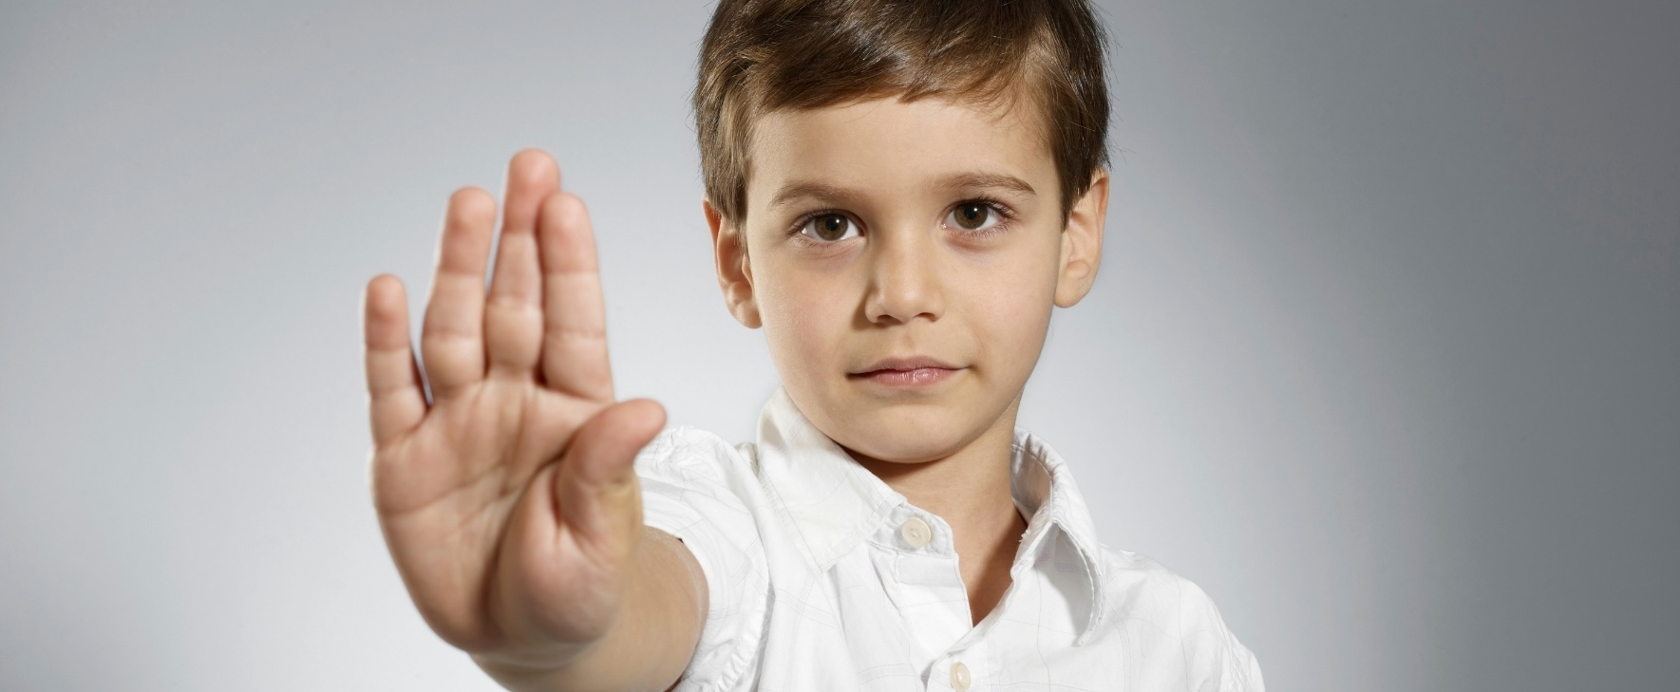
If I do not want a hug, I can say no.

Slide 6
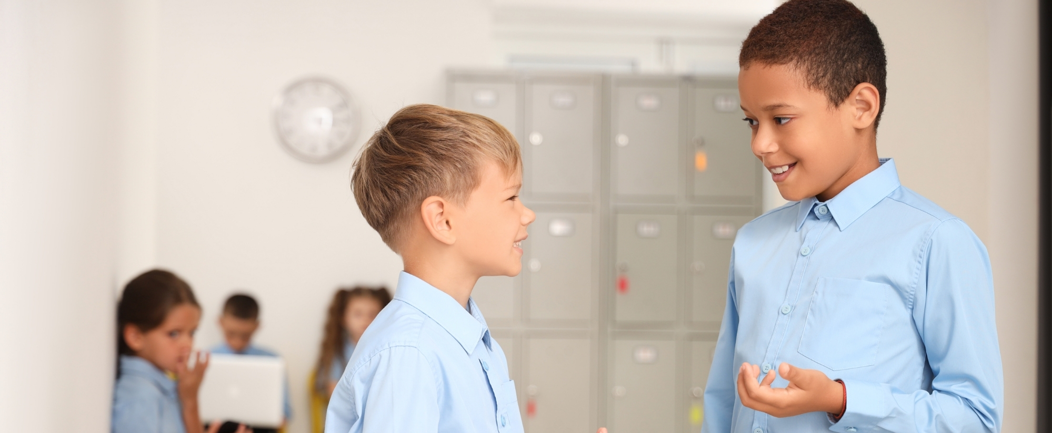
If I am unsure if a trusted person wants a hug, I will ask them. It is okay if they say no.

Slide 7


The goal of this page is to teach the child about getting consent from others and how to respond to someone saying no.
If a friend or family member says no to a hug, I can ask if they would like a high five or fist bump instead.

Slide 8
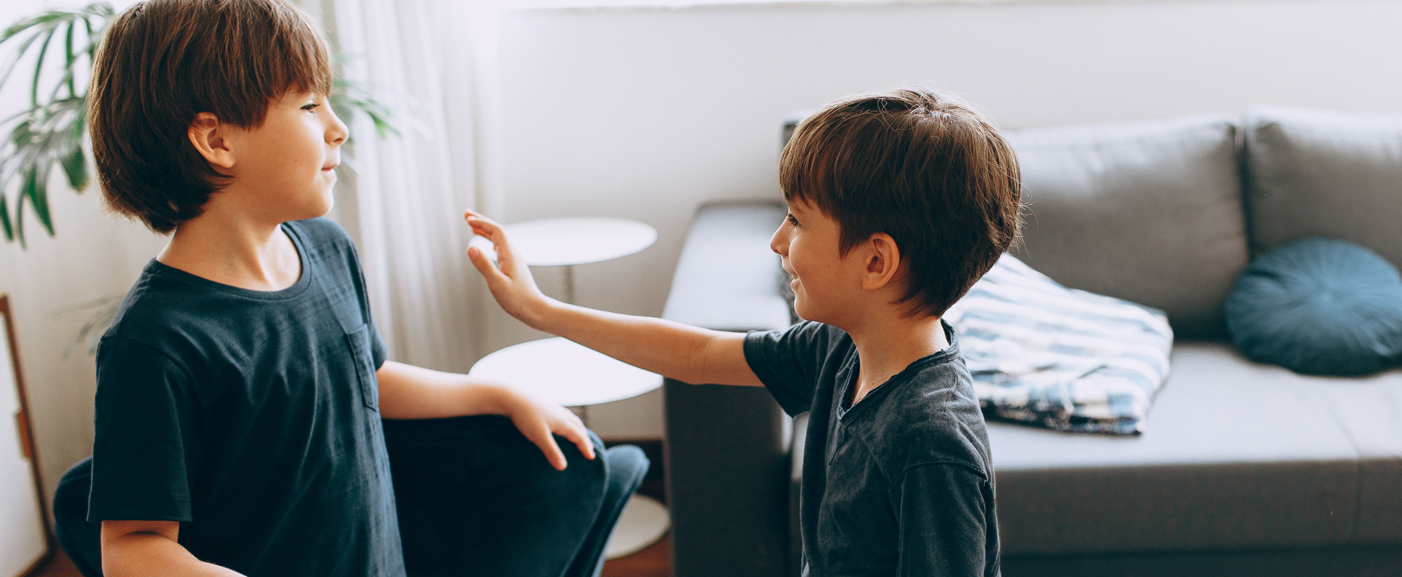
Friends and family can change their minds about hugging. That's ok.
I can also change my mind about hugs. That’s ok too.

Slide 9
As this child hugs for emotional and sensory reasons, it’s important for them to have an alternative if a hug is not available or appropriate. In this situation, the child can squeeze their teddy or another sensory tool for regulation.
If no one I trust says yes to a hug, I can squeeze my teddy. I will have my fidget spinner with me too. This makes me feel good.

Slide 10

It is important to emphasise that hugs are positive when they are with a child's trusted people when they consent.
Hugs are great to share with friends and close family. It shows them that I care.

Slide 11
For more information, contact:
Amaze
678 Victoria Street,
Richmond VIC 3121
Phone: 03 9657 1600
e: info@amaze.org.au
W: www.amaze.org.au
National Office for Child Safety
3-5 National Circuit,
Barton ACT 2600
e: NationalOfficeforChildSafety@ag.gov.au
W: ChildSafety.gov.au

