Slide 1

How to share my ideas and suggestions
A child safe organisation means children and young people can contribute and actively participate in building an organisational culture that is safe for them. This means providing ways for children and young people to give feedback.
This social script is a way to teach children how to share their ideas within an organisation.

Slide 2

At [insert organisation name/type], I can share my ideas.
I might have ideas about how to make things better.

Slide 3

In this example, there is an ideas box where children can write or draw their ideas. A staff member has also been identified as an alternative option for feedback. It is important that there are multiple options for feedback, so it is accessible for everyone.
If I have an idea I want to share, I can put it in the ideas box.
I can also talk to [insert staff member’s name] about my ideas and suggestions.

Slide 4

Children and young people may not know what kinds of things they can share feedback on. This social script has several ideas for topics children might want to raise with the organisation. This helps teach self-advocacy skills.
If I don’t understand something, I can say something like “This is hard for me, I need help.”

Slide 5

If something is unfair, I can say something like “I think I was treated differently. Can we talk about it?”

Slide 6

If I feel left out or if someone else was left out, I can say something like “I feel upset because I didn’t get a turn. Can we talk about it?”

Slide 7
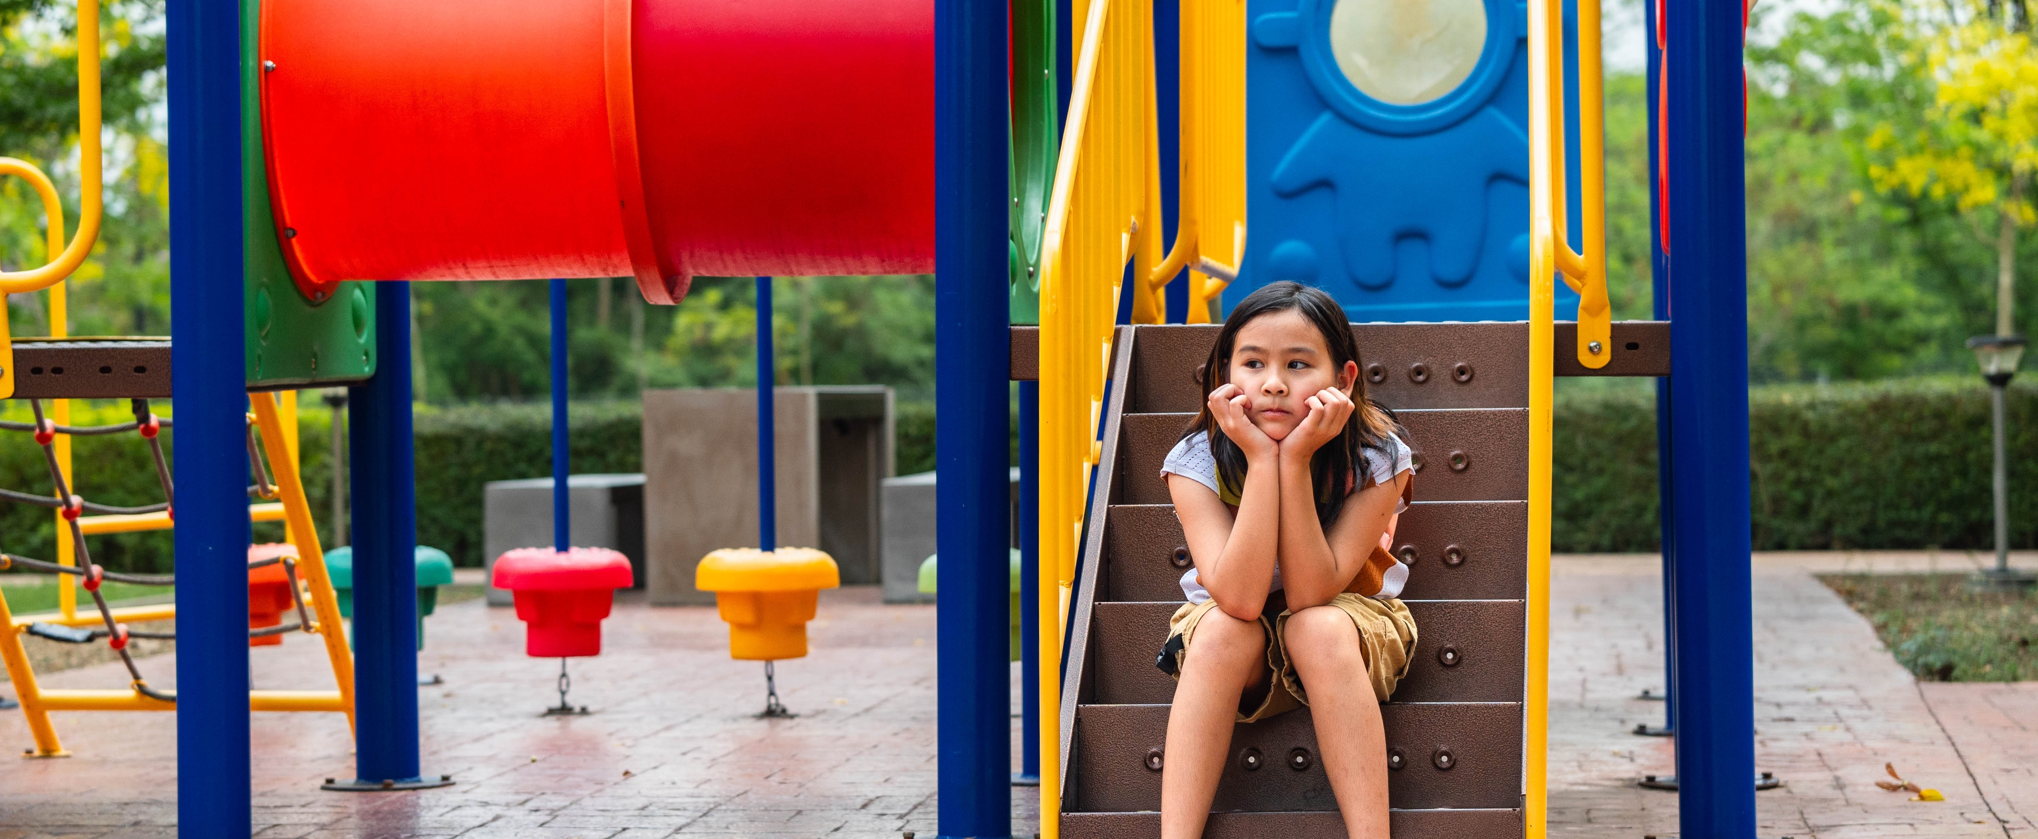
If I don’t like something, I can say something like “I don’t like this. Can I do something different?”

Slide 8

If I have an idea to make something better, I can say something like “Can I tell you about an idea I have?”

Slide 9
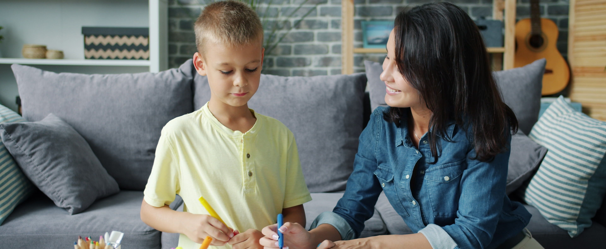
If someone does something that makes me feel unsafe, I can say something like “[insert name] did something I didn’t like, can you help me?”

Slide 10

If your organisation has a specific process for managing feedback, explain that here in terms that children will understand.
Adults at [insert organisation name/type], should listen to me, take my ideas seriously and explain what will happen next.
They might not change everything, but my ideas still matter.

Slide 11

Your organisation may also want to include other ways that children can seek support outside of the organisation like through Kids Helpline.
When I share my ideas, the [insert organisation name/type], can learn and be safer and better for everyone.

Slide 12
For more information, contact:
Amaze
678 Victoria Street,
Richmond VIC 3121
Phone: 03 9657 1600
e: info@amaze.org.au
W: www.amaze.org.au
National Office for Child Safety
3-5 National Circuit,
Barton ACT 2600
e: NationalOfficeforChildSafety@ag.gov.au
W: ChildSafety.gov.au

